Slide 1

Churn Telecom Analysis Project
Lab Group: J
By: MA YIWEI, MD JAMAL UDDIN RASEL

Slide 2
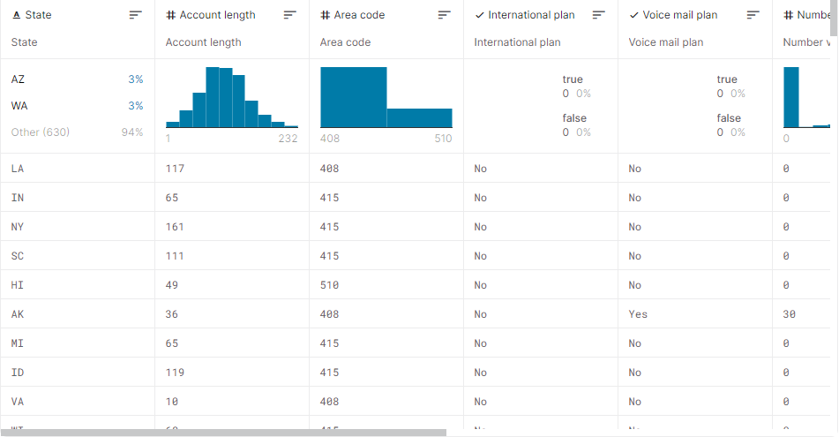
Dataset
The dataset we used is the telecom churn datasets from Kaggle
The data has rich, machine readable file format and metadata. We can observe in dataset that most of the features are numerical datatype and data contain no missing values. So, it's a suitable data for analysis and developing machine learning model.
Source for dataset:
https://www.kaggle.com/mnassrib/telecom-churn-datasets

Slide 3
Problem Definition
The telecom firm is experiencing a high rate of client turnover and is unable to pinpoint the cause. We'll create a comprehensive analysis report on the role of various factors in customer turnover, as well as a features-based forecasting model.
Can we develop reliable prediction model for customer churn for the company? We'll develop a detailed report of different accuracy metrics for the classification model
Which model would be the best to predict it?

Slide 4
Summary
The telecom firm is experiencing a high rate of client turnover and is unable to pinpoint the cause. They want us to write an analysis report on which services should be upgraded in order to keep their customers for lifetime.
We'll create a comprehensive analysis report on the role of various factors in customer turnover, as well as a features-based forecasting model.
The predictive algorithm will be able to take company-provided services(features) as input and predict whether or not a customer would churn in the future. Based on input features, we want to build a model that can predict if a client would Churn or Retain (encoded as 0's and 1's). So, it implies that we need to develop supervised classification model.

Slide 5
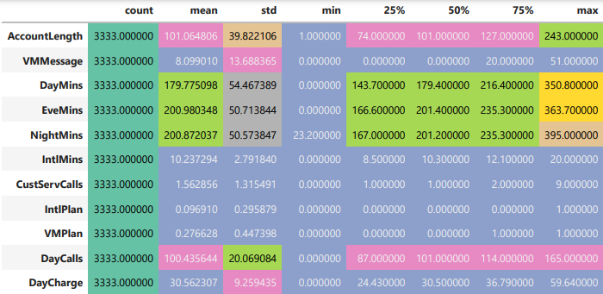
Data understanding, exploration, and visualization
To begin descriptive analysis, just look at what types of ranges each feature has and how much they move about their average values.
This gives us statistics on the average churn rate of users in the dataset right away. We can observe that on average, 14.49 percent of customers churn.

Slide 6
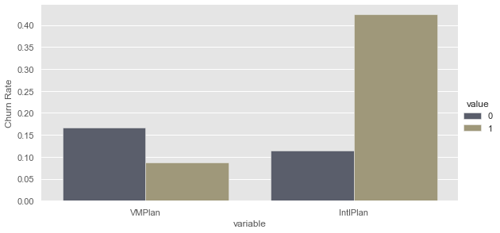
Visualization for Descriptive Analysis
We looked about how the average churn rate differs based on whether we have a voicemail or an international plan before. It would be amazing, though, if we could see the same outcomes.

Slide 7
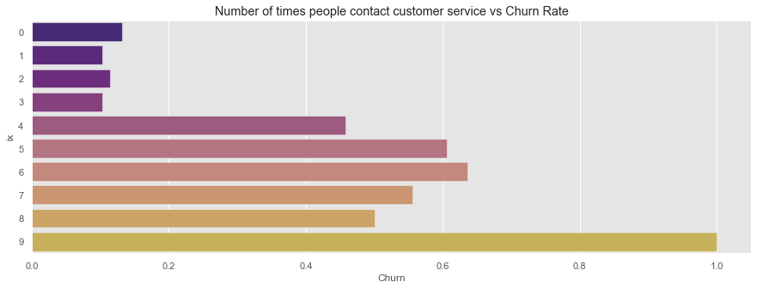
Contact to customer service and churn rate
This is an intriguing observation: consumers who call customer support more frequently also churn more: intriguing, but not surprising.

Slide 8
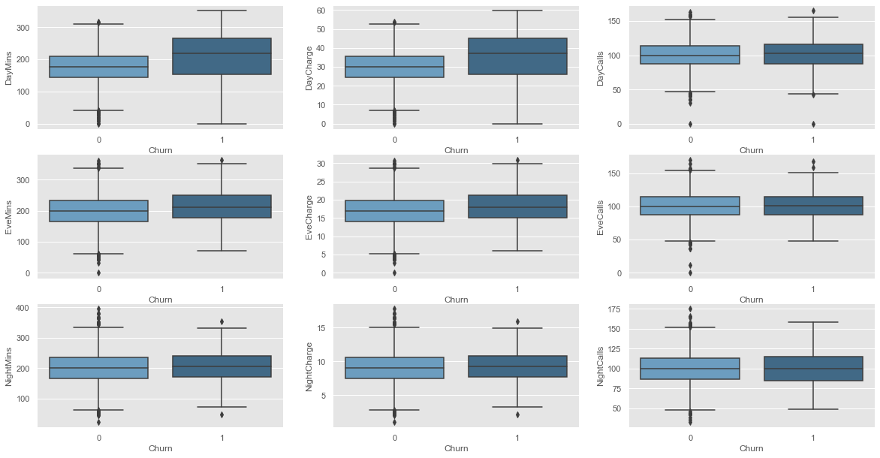
Boxplot to compare the target variable with different numerical features
Boxplots are a better approach to show how features are distributed because we're working with bigger ranges and more continuous characteristics.
To make the story more accessible, we used the dark grid background from the seaborn library. The Day Mins and Day Charge graphs are the most fascinating of all the others. These two will very certainly be linked, as the fee will be based on the number of minutes utilized and a tariff.

Slide 9
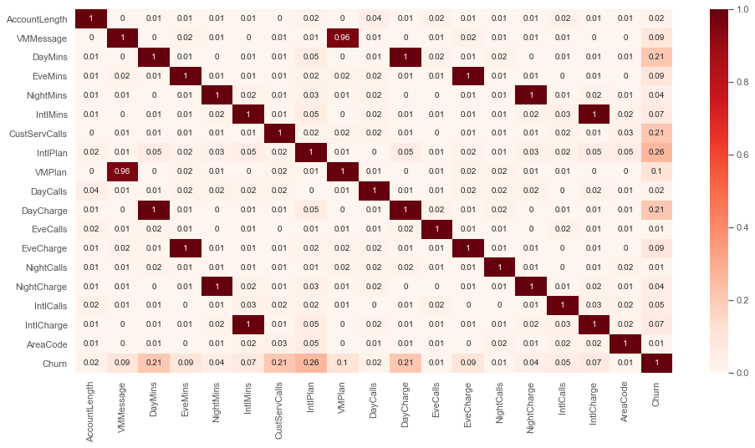
Correlation of features:
We can depict from the above plot that Churn feature has significant positive correlation with Day Mins (0.21), Cust Serv Calls (0.21), Intl-Plan(0.26) and Day-Charge(0.21) compared to other variables in the data.
These features would be most significant predictors in developing a classification model for customer churn predictions. The values with higher correlation coefficient have darker red color in squares.

Slide 10
Model Development
To develop a predictive classification model for customer churn, we’ll perform standard scaling of data and include only those features that have higher correlation with target variable(churn)
We have applied three different classification models, K-Neighbor classifier, Support vector machine and Logistic Regression Model.
After optimizing hyperparameters, the KNN model achieves the highest accuracy of 86.60 percent. By integrating more relevant characteristics in the classification model and including more training data in the model, the predictive model's accuracy can be further improved.

Slide 11
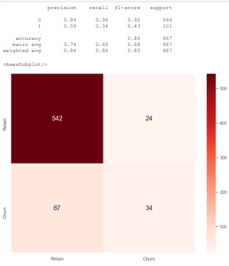
Model Performance:
We divided the data into two parts to see how our model performs on real-world data: training data and testing data.
The Testing dataset serves as unknown data for the model after it has been trained using training data.
We'll create a confusion matrix to describe prediction outcomes on a classification issue, as well as a classification report that shows precision, recall, and the f1-score of classification.

Slide 12
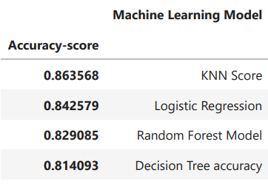
Compare the performance of three classification models using Accuracy-score
The above results shows that KNN and Logistic Regression have highest accuracy scores for classification.
After optimizing hyperparameters, the KNN model achieves the highest accuracy of 86.60 percent. By integrating more relevant characteristics in the classification model and including more training data in the model, the predictive model's accuracy can be further improved.

Slide 13
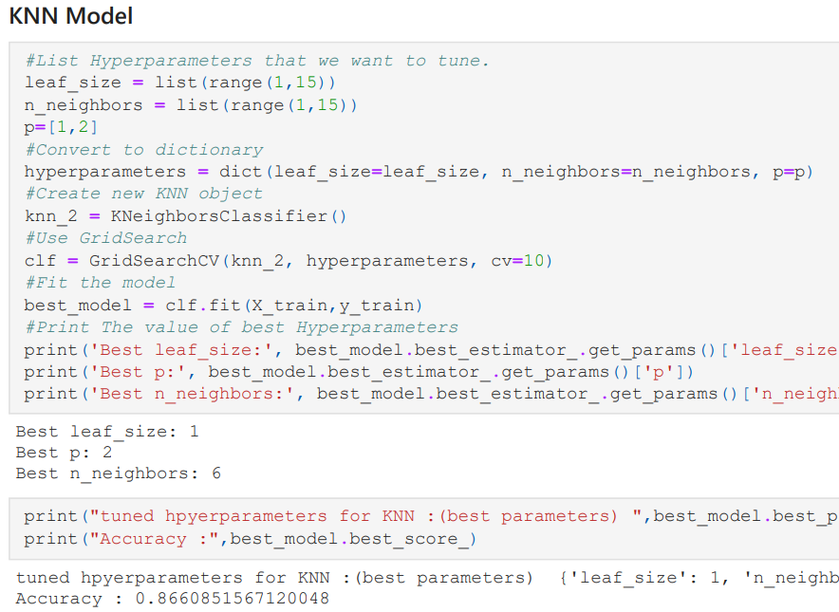
Conclusion
After optimising hyperparameters, the KNN model achieves the highest accuracy of 86.60 percent.

Slide 14
THE END

